Slide 1
What are the most common venues in major Central Business Districts (CBDs)?

Slide 2
Introduction
Will help provide the results to businesses who are intereted in finding out the most popular businesses to set up in CBDs in the world

Slide 3
Data and Methods
Will explore the venue data (venue name and venue categories) from Foursquare for 3 World's CBDs and compare to find the most common venues:
Raffles Place (Singapore)
Midtown (Manhattan, New York)
Canary Wharf (London)
Use Wordcloud to generate visualization of most popular venues based on frequency

Slide 4
Most common venues of CBDs
Plaza
Bar
Hotel
Café
French Restaurant
Coffee Shop
Salad Place
Sandwich Place
Mexican Restaurant
Japanese Restaurant

Slide 5
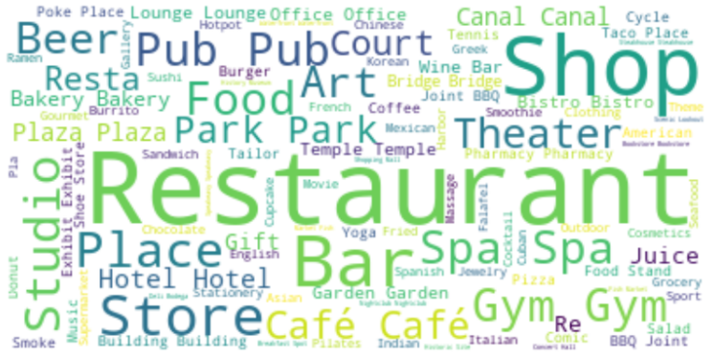
Most popular venues in terms of frequency

Slide 6
Conclusion
Recommendations:​
Risk-averse business owners may be more keen to opening businesses that have been proven to be common/popular in CBDs as listed
Risk-lovers, in opposite, may prefer to open businesses that are not yet too common and thus may want to introduce something more unique

